Slide 1










Shubham Vishwakarma
Aditya Yadav
Afzal Ansari
Student grade prediction using ML

Slide 2









Agenda
1
Why do we need Machine Learning?
2
Library
3
Life cycle to build a model with ML
4
Logistic Regression?
5
Supervised Learning: Linear Regression
6
Student grade prediction using ML

Slide 3
About the Dataset:
Dataset:
Student data consumption.
Source: www.Kaggle.com/excelsheet
396 Students observation based on 33 attributes.
Target Variable G3(final Grade).
Goal: To predict student grade based on demographic and social factor.

Slide 4
Data Preparation:
No missing values in Dataset.
Categorical variable transformed to factor Variables.
G3 variable was converted from continuous.
variable(numeric 0 to 20 ) to discreate variable(Pass/Fail Grade).
Dataset split into training and test set in 80:20 ratio.

Slide 5
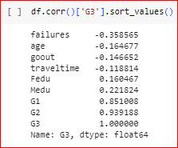
Stepwise Regression:
Fig: Significant variables obtained after performing multiple regression

Slide 6


Life cycle To build a model with Machine Learning
Understand the business problem
Data Acquisition
Data Cleaning
Exploratory data Analysis
Deploy the model
Predict your model accuracy
Machine Learning Algorithm

Slide 7




Why do we need Machine Learning?
In the past, we used to have data in a structured format but now as the volume of the data is increasing, so the number of structured data becomes very less, so to handle the massive amount of data we need data science techniques
Those data can be used to get the proper business insights and the hidden trends from them.
These insights helps the organization to predict the Future
Helps to reduce the production cost
Build model based on the data to give the ability to the machine to predicts on its own
Why machine Learning becomes more popular these days?

Slide 8


What is Supervised Learning?
Supervised learning works as a supervisor or teacher. Basically, In supervised learning, we teach or train the machine with labeled data (that means data is already tagged with some predefined class). Then we test our model with some unknown new set of data and predict the level for them
Learning from the labelled data and applying the knowledge to predict the
label of the new data(test data), is known as Supervised Learning
Types of Supervised Learning:
Linear Regression
Logistic regression

Slide 9
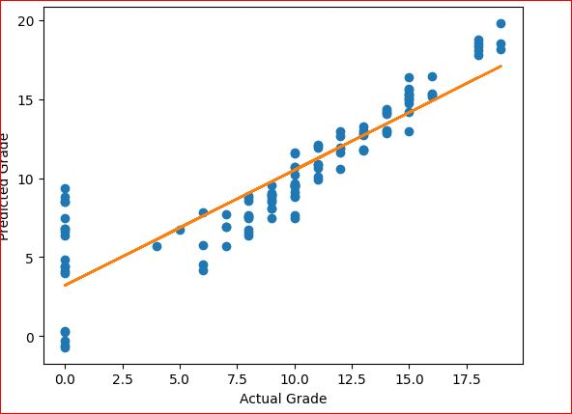
Linear Regression
Linear regression is a statistical technique used to model the
relationship between a dependent variable and one or more independent variables .
Data Collection:
You start by collecting data on your dependent and independent variables.
Model Fitting:
use statistical methods to fit a straight line or plane to your data.
Prediction and Interpretation:
You can also analyze the slope and intercept of the line or plane to understand the direction

Slide 10
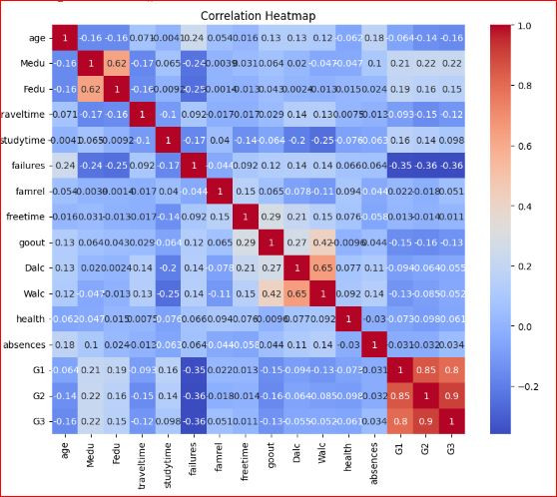
Logistic Regression:
It is Supervised algorithm.
Logistic Regression is a classification algorithm that predicts binary outcomes using a sigmoid function.
It learns the relationship between features and outcomes, sets a decision boundary, and makes predictions based on probabilities.
It is widely used for binary classification tasks.
Data Preparation
Model Training
Decision Boundary
Model Evaluation

Slide 11
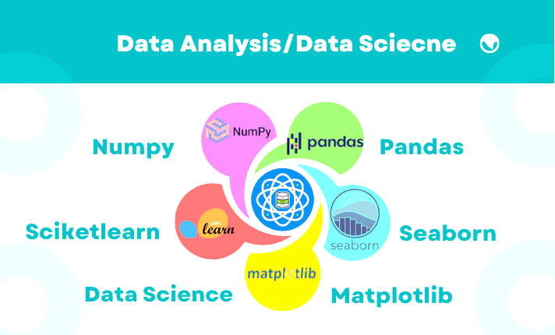
Libraries
NumPy
Seaborn
matplotlib
Pandas
Sklearn

Slide 12
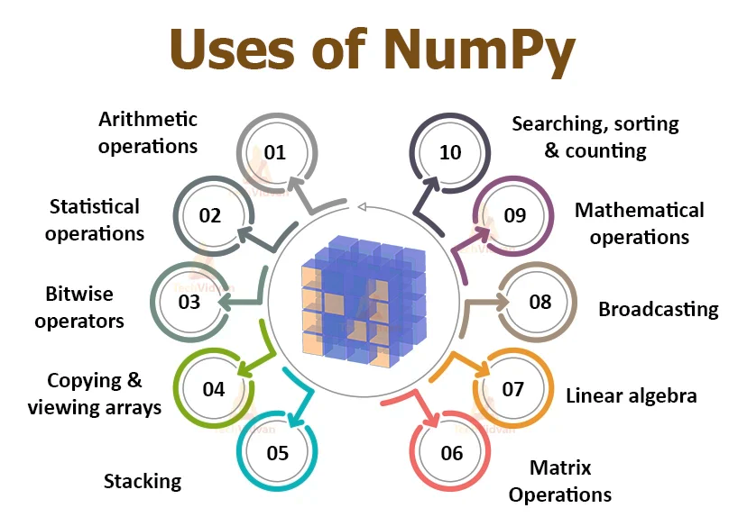
NumPy
you need to perform complex mathematical calculations or crunch large amounts of data, NumPy.
It's widely used in fields like data analysis, machine learning, and scientific research

Slide 13
Libraries:
Seaborn:
designed specifically for statistical data visualization
helps you bring your data to life with beautiful and informative visualizations.
. It offers a wide range of plots, such as scatter plots, bar plots, heatmaps, and more.
Matplotlib:
you're a scientist, engineer, data analyst, or just someone who enjoys exploring data visually.

Slide 14
Libraries:
Pandas:
you can easily load, clean, transform, and analyze data. It offers a wide range of functions and methods to handle missing values, filter and sort data, perform computations, and much more.
Pandas also integrates well with other libraries in the data science ecosystem, such as NumPy and Matplotlib, making it a valuable tool for data exploration and visualization.
Sklearn:
machine learning tasks, along with helpful utilities for data preprocessing, model evaluation, and model selection.

Slide 15
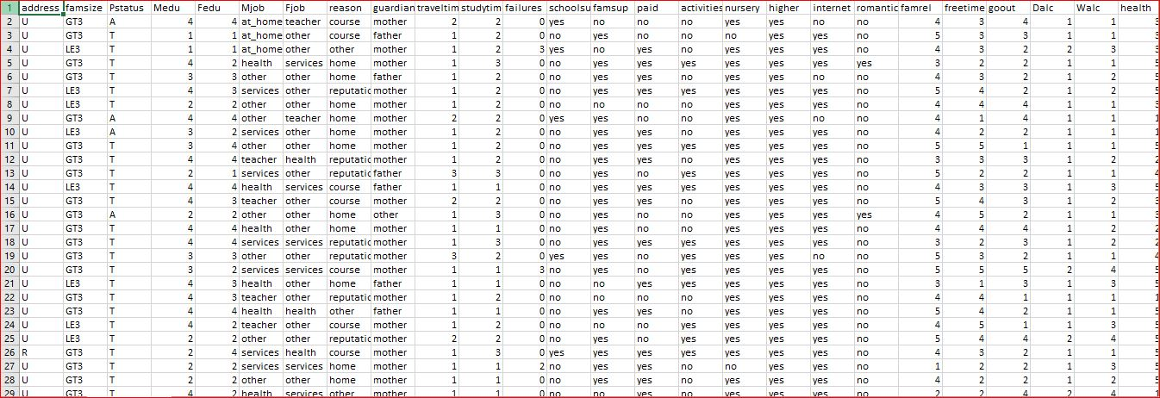
Data:

Slide 16
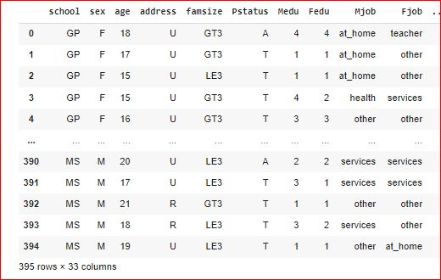
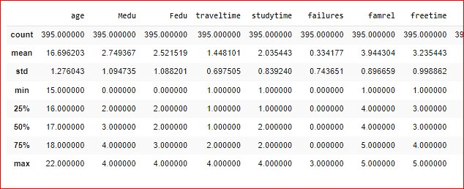



Perform Model?
Training Data
Model Building
Testing Data

Slide 17
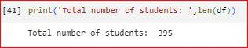
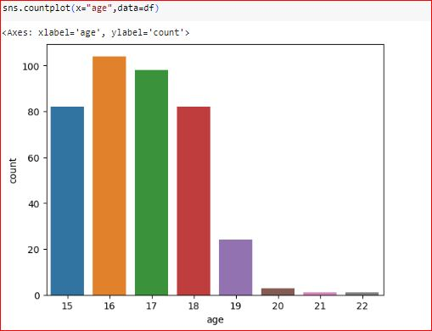
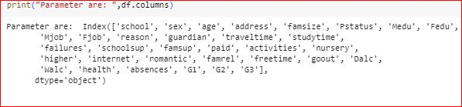
Attributes:

Slide 18
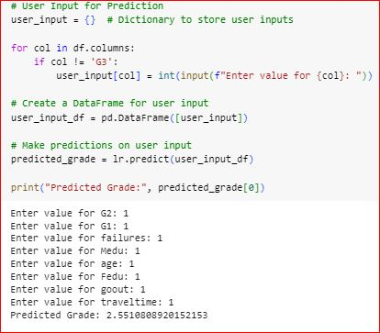
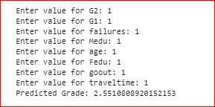
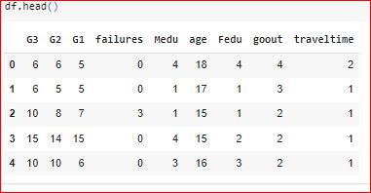
Take User Input
Take User Input:
Output:

Slide 19
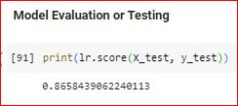
Accuracy:
Accuracy = 86.58%

Slide 20
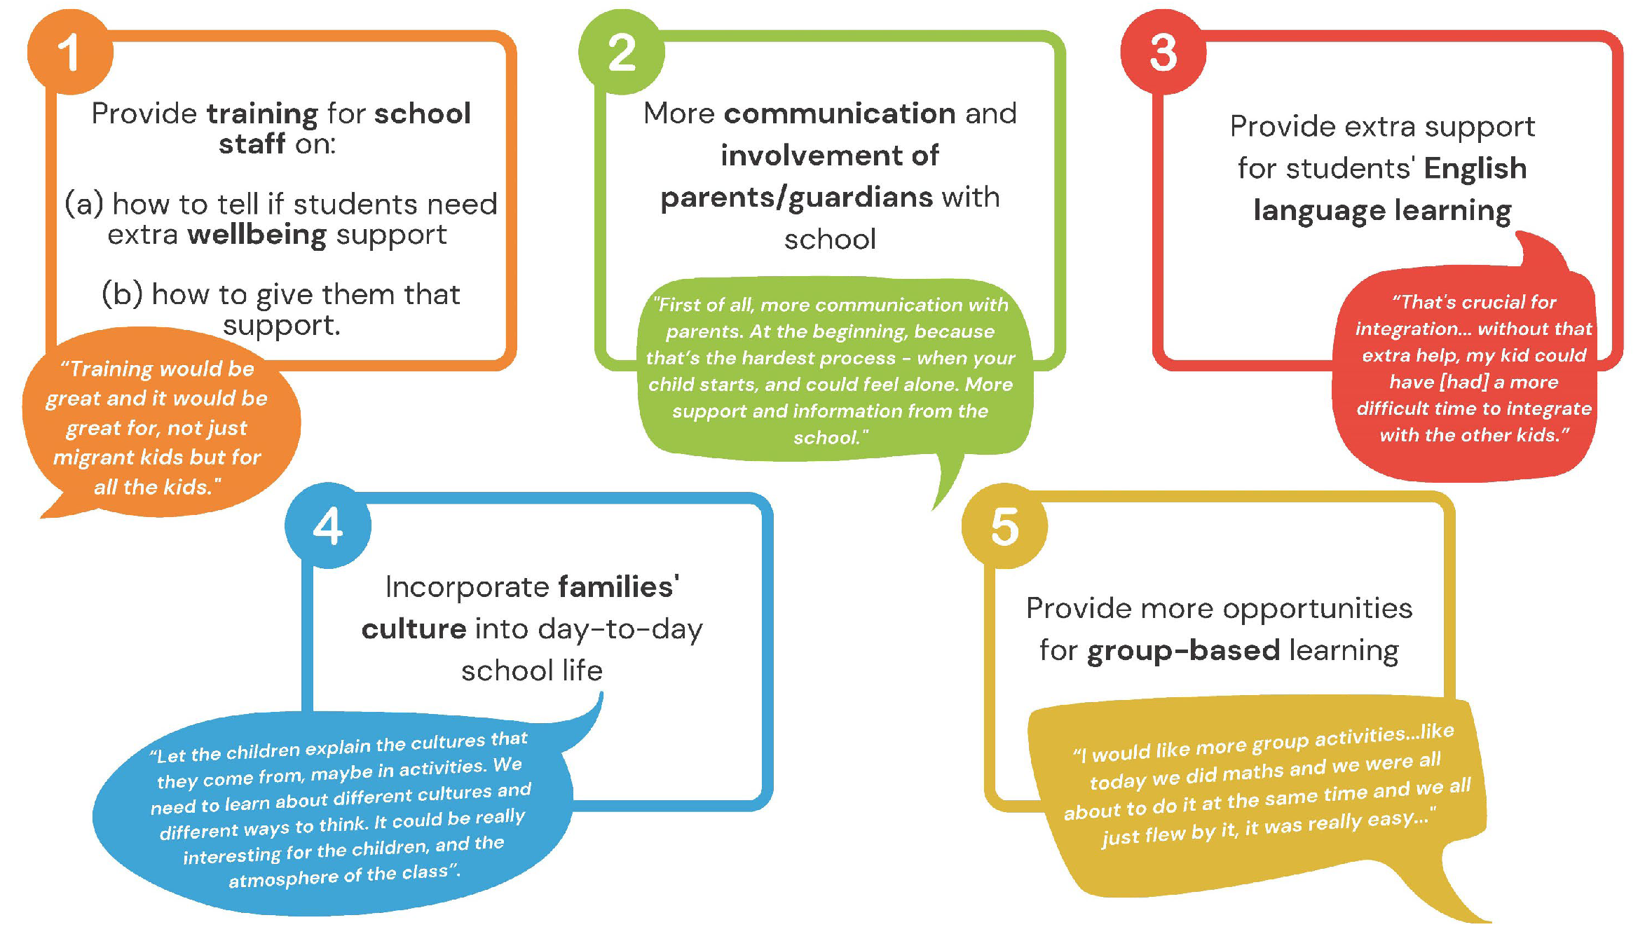
Advantage:

Slide 21
Conclusion:
Variables like Dalc & Walc don’t play an important role in determining the student grade.
Failure, sex, age, freetime, gout, traveltime and absence are statically significant.
Tested classification algorithm returned similar accuracy range(78-86%).
Similar accuracy obtained on performing classification using Principal components.

Slide 22

Student grade prediction using ML

